Slide 1
Introduction to IT Security
.
MTT06105: | FUNDAMENTALS OF IT SECURITY

Slide 2
What is “Security”
Security can be defined as state of freedom from a danger, risk or attack.
Information security can be defined as the task of guarding information which is processed by a server, stored on a storage device, and transmitted over a network like Local Area Network or the public Internet.
Information security means protecting information and information systems from unauthorized access, use, disclosure, disruption, modification or destruction

Slide 3
What is “Security”
Computer Security - generic name for the collection of tools designed to protect data and to thwart hackers
Network Security - measures to protect data during their transmission in a communication network
Internet Security - measures to protect data during their transmission over a collection of interconnected networks.

Slide 4
Why do we need security?
Protect vital information while still allowing access to those who need it
Trade secrets, medical records, etc.
Provide authentication and access control for resources.
Guarantee availability of resources.

Slide 5
Who is vulnerable?
Financial institutions and banks
Internet service providers
Pharmaceutical companies
Government and defense agencies
Contractors to various government agencies
Multinational corporations
ANYONE ON THE NETWORK

Slide 6
Characteristics of Computer Intrusion
A computing system: a collection of hardware, software, data, and people that an organization uses to do computing tasks
Any piece of the computing system can become the target of a computing crime.
The weakest point is the most serious vulnerability.
The principles of easiest penetration

Slide 7
Security Breaches-Terminology
Exposure
An exposure is an instance of being exposed to losses from a threat agent.
E.g.:If password management is weak and password rules are not enforced, the company is exposed to the possibility of having users' passwords captured and used in an unauthorized manner.
Vulnerability : A weakness in the system.
A vulnerability is a weakness or exploit that could cause harm, loss or exposure to an information asset.
Attack
Any action that compromises the security of information owned by an organization.

Slide 8
Security Breaches-Terminology
Threats
Any potential danger to information or systems.
A Threat can be defined as anything which is danger to an organization's Asset
A threat is anything (incidental or deliberate) that could cause potential harm, loss or exposure to an information asset.
E.g. Human attacks, natural disasters, errors
Control – a protective measure
Assets – hardware, software, data

Slide 9
Vulnerabilities, Threats, and Controls
Vulnerability = a weakness in a security system
A threat is a potential violation of security.
Threat can be anything that can take advantage of a vulnerability to breach security and negatively alter, erase, harm object or objects of interest.
Controls = means and ways to block a threat, which tries to exploit one or more vulnerabilities.

Slide 10
Classes of Threats
Interception
–an unauthorized party (human or not) gains access to an asset
Interruption
–an asset becomes lost, unavailable, or unusable
Modification
–an unauthorized party changes the state of an asset
Fabrication
–an unauthorized party counterfeits an asset

Slide 11
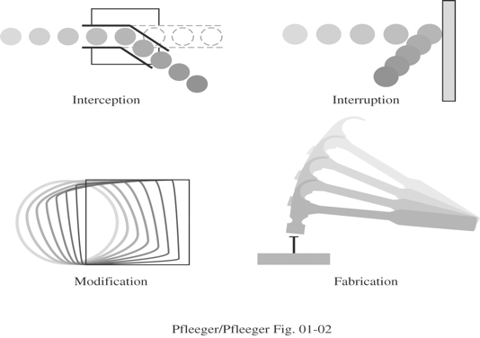
Classes of Threats
System Security Threats.

Slide 12
Categories of Threats
These security threats can be categorized as external versus internal, and unstructured versus structured.
External and Internal Threats
Security threats can come from two locations:
External users
An external security threat occurs when someone outside your network creates a security threat to your network.
Internal users
An internal security threat occurs when someone from inside your network creates a security threat to your network.

Slide 13
Categories of Threats
Unstructured and Structured Threats
General methods of security threats fall under two categories:
Unstructured threats
An unstructured security threat is one created by an inexperienced person who is trying to gain access to your network.
Structured threats
A structured security threat, on the other hand, is implemented by a technically skilled person who is trying to gain access to your network.

Slide 14
Types of Threats
Worms
This malicious program category largely exploits operating system vulnerabilities to spread itself.
Viruses
Programs that infected other programs, adding their own code to them to gain control of the infected files when they are opened.
Trojans
Programs that carry out unauthorized actions on computers, such as deleting information on drives, making the system hang, stealing confidential information, etc.

Slide 15
Types of Threats
Spyware
Software that collects information about a particular user or organization without their knowledge. You might never guess that you have spyware installed on your computer.
Riskware
Potentially dangerous applications include software that has not malicious features but could form part of the development environment for malicious programs or could be used by hackers as auxiliary components for malicious programs.

Slide 16
Types of Threats
Rootkits
Utilities used to conceal malicious activity. They mask malicious programs to keep anti-virus programs from detecting them.
Rootkits modify the operating system on the computer and alter its basic functions to hide its own existence and actions that the hacker undertakes on the infected computer.

Slide 17
Sources of Threats in IT
The sources of security threats in IT can be categorized as External sources and Internal sources,
Security threats can come from two locations:
External users
An external security threat occurs when someone outside your network creates a security threat to your network.
External, including cyber criminals, hackers, internet scams, unprincipled partners, and criminal structures.

Slide 18
Sources of Threats in IT
Internal users
An internal security threat occurs when someone from inside your network creates a security threat to your network.
Internal, including actions of company staff and users of home PCs. Actions taken by this group could be deliberate or accidental.

Slide 19
Sources of Threats in IT
Internal users
Interestingly, the CSI study has found that, of the 70 percent of the companies that had security breaches, 60 percent of these breaches come from internal sources.
CAUTION
Most security threats are internal. Therefore, when you design a security solution, you must address this issue by using internal measures to protect important resources.

Slide 20
Security Attack

